Slide 1
Deliverable 9
Group 6 - Unpaid Interns
Cameron Beck
Cameron Stamps
Luke Wittbrodt
Mohab Yousef

Slide 2
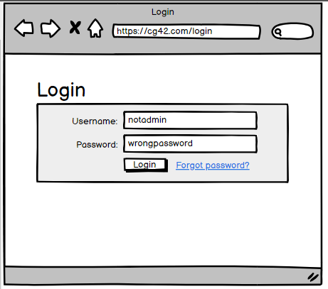
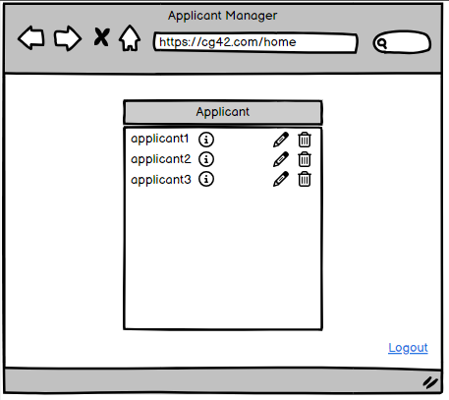
Demo of Prototype
For our demo we decided to use Balsamiq. We chose this tool because it was very flexible and intuitive. It allowed us to build models quickly and make modifications in an effective manner.
Try out the demo here
Screenshot of demo login screen
Screenshot of demo applicant manager

Slide 3
Testing Plan
Objective: Providing an easy to navigate and convenient method of storing information about candidates for hire.
The user is able to log in and access information about a candidate.
The application is simple to navigate.
Scope: Creating a minimalistic application that stores information.
In-Scope: Pulling information from the server, accessing information as an admin.
Out Scope: The flow of the webpages are concise and easy to navigate.
Testing Methodology: Getting a user to login and navigate to candidate information.
Approach: Working with the client to build an application to their liking, then getting feedback once they’ve used the application.

Slide 4
Testing Plan
Assumption: The user has correct login information and doesn’t need to retrieve any lost information. There are 3 candidate profiles already logged into the application.
Risk: If the user wants to manually add more profiles or losses information there is no way to go about this with the current demo.
Mitigation Plan: With simple contact with the developers, any lost information and be retrieved. More candidate profiles could be manually added in its current state.
Roles and Responsibilities: Test manager must distribute the test to the client and get feedback. Tester should be able to assess their own performance when working with the application.

Slide 5
Testing Plan
Schedule: Dates of the test will be recorded.
Defect Tracking: The client will be able to report of any issue arise while testing the application.
Test Environments: The client will use the current demo in Balsamiq to test.
Entry Criteria: Testing begins when the client reaches the login screen.
Exit Criteria: Testing ends when the client is able to access candidate information.
Test Automation: The test is automated (not manual).
Effort Estimation: A team member must be present during the testing to assist if the client runs into any trouble. This will also help with assessing what needs to be modified.

Slide 6
Testing Plan
Testing Deliverables: At the end of the test the client will be given a Google Form to fill out. This will help the developers gain insight on how the client reacted to the demo.

Slide 7
Instruments collected to develop feedback
We used a Google Form to collect feedback from to client. This helped us gain some insight on what was working with our current demo, and what still needed to be modified.
The Google Form the client filled out can be found here.

